Slide 1
Treasury Management
Clearing and Settlement Systems

Slide 2
Overview of Clearing and Settlement Process
Clearing is all steps involved in transferring funds ownership from one party to another except for final step which is settlement
Settlement involves the finalization of payment so that a new party takes possession of transferred funds
Treasurer should be aware of the processes in order to understand the timing of payment transfers

Slide 3
Overview of Clearing and Settlement Process
In clearing and settlement systems, the banks for the payer and beneficiary exchange information regarding monetary transfers
The result of this exchange is payments between the banks.
The banks, in turn credit the account of the beneficiary and debit the account of the payer

Slide 4
Overview of Clearing and Settlement Process
Clearing and settlement systems are generally organised around individual countries or economic regions
Banks located within these areas can have an account with the local clearing and settlement institution and settlement takes place between the accounts of the banks held at the clearing institution

Slide 5
Overview of Clearing and Settlement Process
Banks located outside of these areas must use a local bank as a correspondent bank that handles payment instructions on their behalf

Slide 6
Settlement Types
Gross basis is where each bank pays the total amount owed.
Payments handled through a gross basis are more likely to have a requirement for immediate execution, where payment instructions are processed separately for each individual transaction
The cost of gross settlement is high, so individual transactions tend to involve larger amounts of funds or are very time sensitive

Slide 7
Settlement Types
Net basis is where a large number of transactions are accumulated and offset against each other, with only the net difference being transferred between banks
Payments usually wait until the end of the day, when all transactions between the banks are summarized and offset against each other
The clearing institution sends the net transfer information to the settlement institution which executes the transfer of funds between the banks

Slide 8
Settlement Types
The cost of net settlement transactions is low, so lower-value transactions are usually settled through these systems.
Banks prefer to use net settlement systems because payments processed through them require reduced funds transfers (i.e. less liquidity) than gross settlement systems.

Slide 9
Transaction Types
High-value payments must be executed immediately
Because of the time constraints, high value payments cannot wait for end-of-day netting and so are settled on a gross basis, with an immediate transfer between the banks
Low-value payments does not require immediate execution and tends to be for smaller amounts.
These payments are handled through a net settlement system

Slide 10
The Continuous Link Settlement (CLS) System
Foreign exchange settlement presents a risk of one party’s defaulting before a transaction has been completed.
This is because settlement takes place through accounts in the correspondent banks in the countries where the relevant currencies are issued.

Slide 11
The Continuous Link Settlement (CLS) System
Because the various national payment systems are located in different time zones around the world, one side of a exchange transaction will likely be settled before the other side of the transaction
For example, dollar payments are settled later than euro payments, which in turn are settled the euro side of the payment before receiving any dollars

Slide 12
The Continuous Link Settlement (CLS) System
If the counterparty were to fail in the midst of this transaction, the initiator would have paid dollars but lost the offsetting euros.
This is called “settlement risk” or “Herstatt risk” after the German Bank that failed.
To avoid this settlement risk, while also speeding up the settlement process, the CLS system was created by a number of banks

Slide 13
The Continuous Link Settlement (CLS) System
This system is operated by CLS Bank International, of which the founding banks are shareholders
Other banks can submit their foreign exchange transactions through these member banks.
Only a select number of foreign currencies are transacted in the CLS system

Slide 14
Electronic Clearing System in Zambia
“Payment Systems play a vital role in the economy of a country. A payment system is a system used to settle financial transactions through the transfer of monetary value and consist of the various mechanisms that facilitate for the transfer of funds from one party (the payer) to another (the payee). A payment system includes the participants (institutions) and the users (customers/clients), the rules and regulations that guide its operation and the standards and technologies on which the system operates.
A well-designed and well-functioning payment positively contributes to the financial stability of the country and to the well-functioning of the country's economy. The role of the Bank of Zambia is to ensure that Zambian payment systems are not only safe, but secure, reliable and efficient “(Source: Bank of Zambia)

Slide 15
Electronic Clearing System in Zambia
The Bank of Zambia has identified a number of payment systems which it has categorized as Systemically Important Payment Systems (SIPS). These are the payment systems whose failure has the potential to trigger systemic risk and have an effect on the wider economy of the country.
The Bank has categorized the following systems in Zambia as being of systemic importance;
Zambia Interbank Payment and Settlement System (ZIPSS)
Electronic Funds Transfer (EFT) System
Cheque Image Clearing (CIC) System

Slide 16
Real Time Gross Settlement System (RTGS)
ZIPSS is an electronic payment system in which processing of transactions for settlement takes place continuously on a transaction basis in real time
ZIPSS was developed to improve the management of payment risks related to high value payments.
It provides a more secure platform for making both large value payments
It also provides quicker final and irrevocable payments

Slide 17
Real Time Gross Settlement System (RTGS)
ZIPSS can be used to make payments that are urgent and time critical such as VAT and securities trading payments because transactions in ZIPSS are processed at the time they are received rather than later
ZIPSS is managed and operated by Bank of Zambia in its capacity as settlement provider
Membership in ZIPSS is open to all banks operating in Zambia

Slide 18
Real Time Gross Settlement System (RTGS)
Benefits of using ZIPSS:
ZIPSS carries negligible credit and settlement risk because it is based on pre-funding of payments before a payment instruction is issued
ZIPSS provides banks with the facility to monitor their settlement balances throughout the day as each transaction takes place in real time

Slide 19
Real Time Gross Settlement System (RTGS)
iii. Due to the continuous nature of transfers, cleared funds are available to the recipient with no significant time lag
iv. ZIPSS/RTGS facilitates the linkage to other transfer systems such as money and capital markets
v. ZIPSS/RTGS enhances treasury management for both banks and bank customers

Slide 20
Real Time Gross Settlement System (RTGS)
vi. Payments that are made on ZIPSS are final and irrevocable
vii. ZIPSS being a real-time settlement system means that payments take effect on appropriate accounts immediately
viii. No minimum or maximum amount is imposed on ZIPSS and therefore customers are able to process both low and large value payments on ZIPSS

Slide 21
Electronic Funds Transfer System
Electronic Funds Transfer (EFT)
The Electronic Funds Transfer (EFT) system is a simple, safe and speedy way to make and collect payments by electronic transfer
Safe and secure transfer of funds from one account to another
Payment of wages, salaries and pensions
Payment of utility bills
Disbursement of loans and collection interest payments by financial institutions
Payment of VAT and other taxes

Slide 22
Electronic Funds Transfer System
Benefits of EFT
Some of the benefits of the EFT system include;
Credit to the customer is given within the same day
Allows a transfer of higher value (has limit than cheques)
It is safe and secure and guaranteed through registered commercial bank
High availability since the service is provided by almost all commercial banks

Slide 23
The Cheque Image Clearing System
The Cheque Image Clearing (CIC) system is a cheque processing and clearing system and allows customers belonging to one bank to write cheques belonging customers of another bank.
Similar to Electronic Funds Transfer (EFT) system, the CIC system is operated by the Zambia Electronic Clearing House Ltd (ZECHL).
With the implementation of the truncation system in 2014, substantial improvement in turn-around time in cheque processing have been achievement. Credit to customer accounts is given on a T+1 basis.

Slide 24
Cheque Truncation System (CTS)
Cheque truncation system (CTS) is a system that involves the process of clearing cheques using cheque images between banks as opposed to using physical cheques presented for payment in a bank by individuals or corporate customers.

Slide 25
The Cheque Image Clearing (CIC) System
Benefits of cheque truncation:
The clearing period has been shortened and standardized across the country to one clearing day (T+1) from (T+3) previously
It has improved the velocity of cash flow between transacting parties in the economy owing to reduced clearing periods
It has reduced the risk associated with manual handling and physical movement of cheques between banks

Slide 26
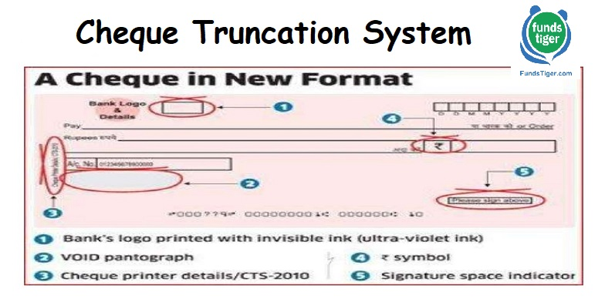
The Cheque Image Clearing (CIC) System

